Slide 1
Installing a DHCP role on the domain controller and adding users in powershell

Slide 2
What is included
Downalding and isntalling of Virtualbox and Windows server 2019
Configuring DC, DHCP, Network on the server
Automatically creating users on the domain

Slide 3
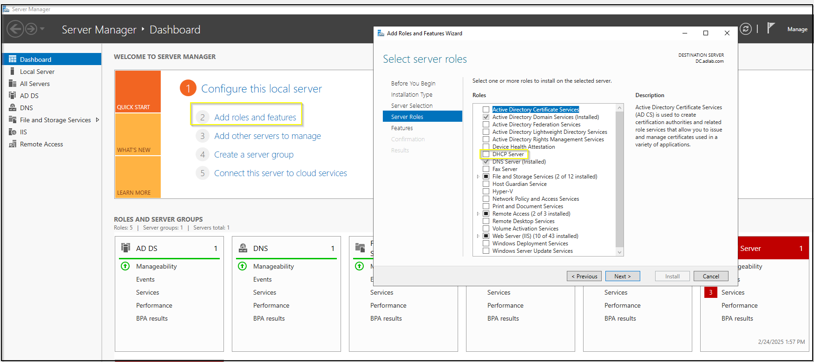
Starting installation of a new role DHCP to the DC, so it can assign IP addresses on the internal network.
Nothing specific on the install wizard just follow with next buttons.

Slide 4
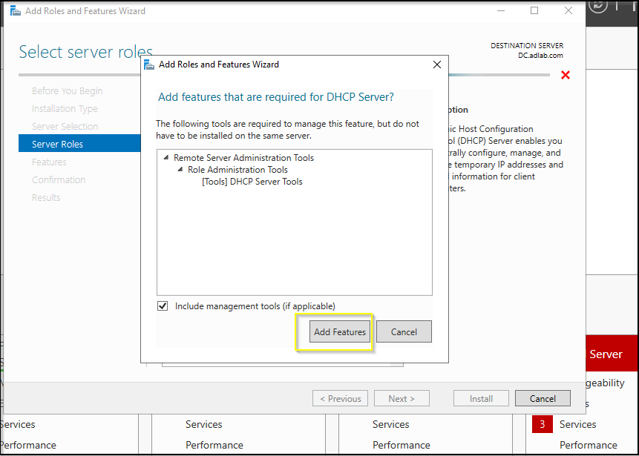

Slide 5
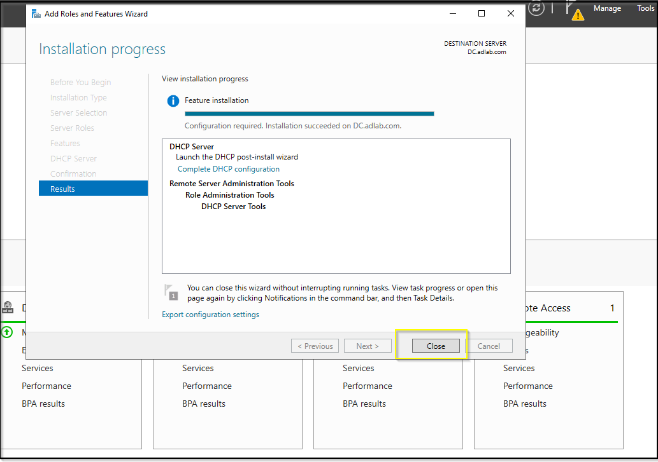
This pic shows finished installation of DHCP on the Domain Controller

Slide 6
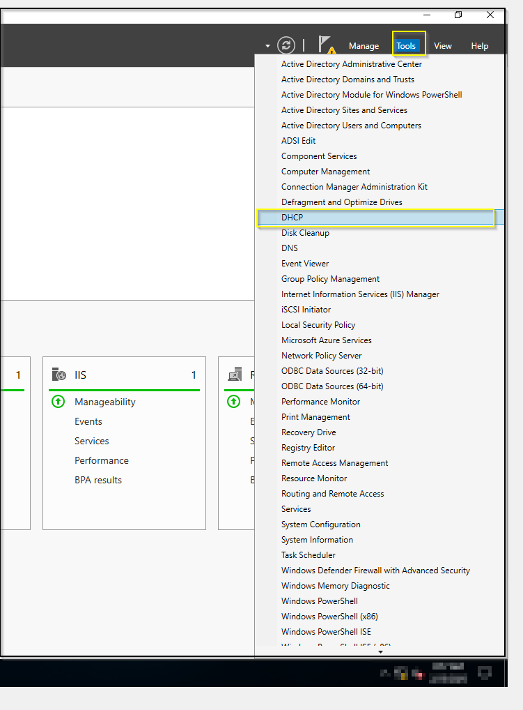
In order to access the DHCP setting you can use the option from the Tools drop down menu.

Slide 7
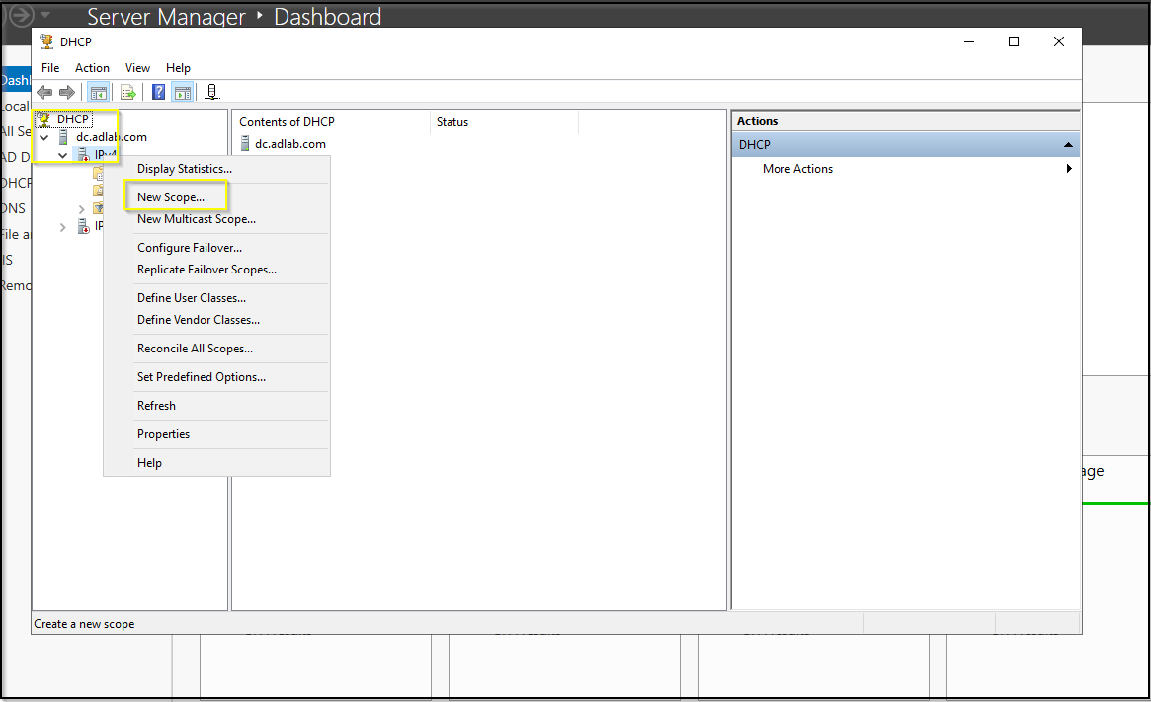
You will have to set up the scope of the IP address

Slide 8
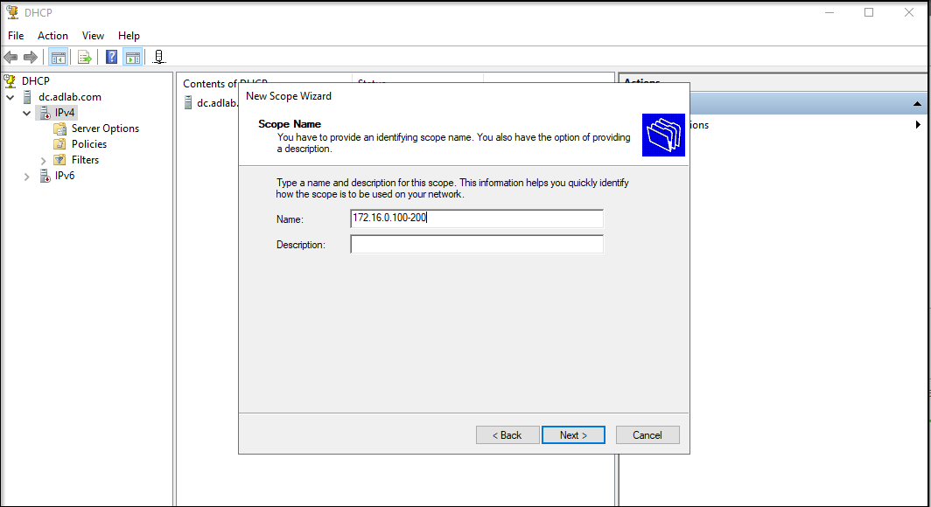

Slide 9
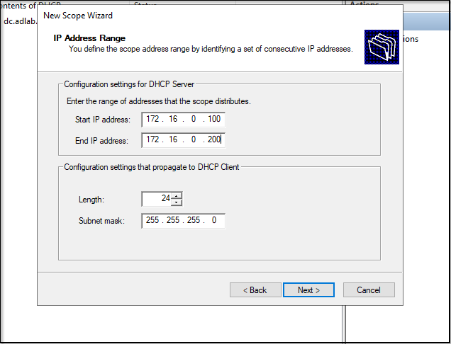

Slide 10
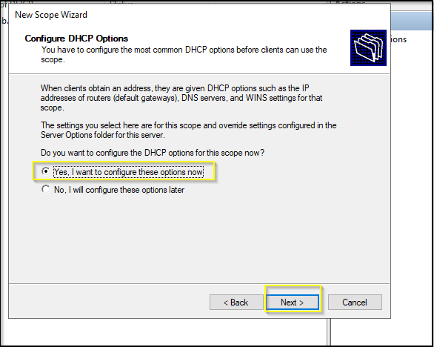

Slide 11
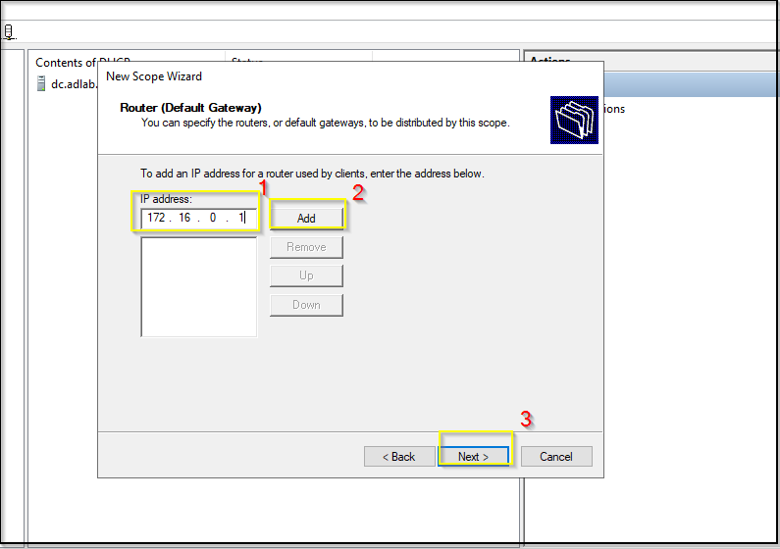

Slide 12
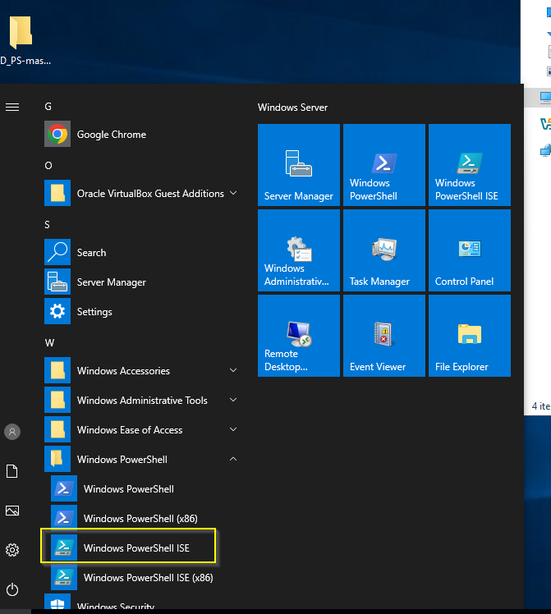
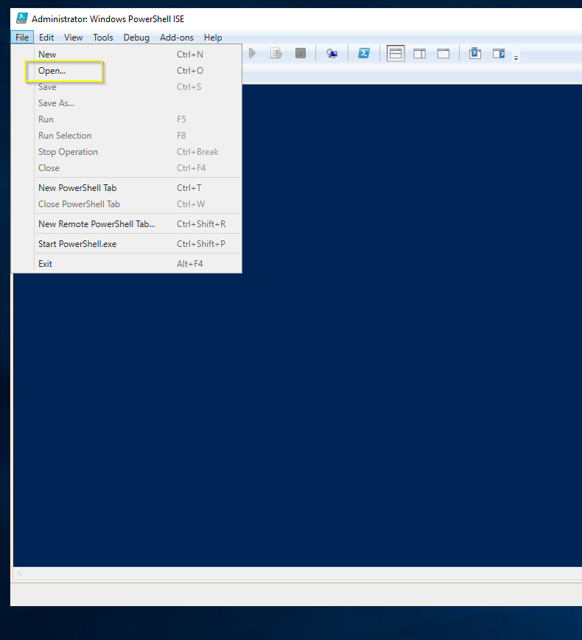
Here we will create users using script in PowerShell. Link for the script on GitHub.

Slide 13
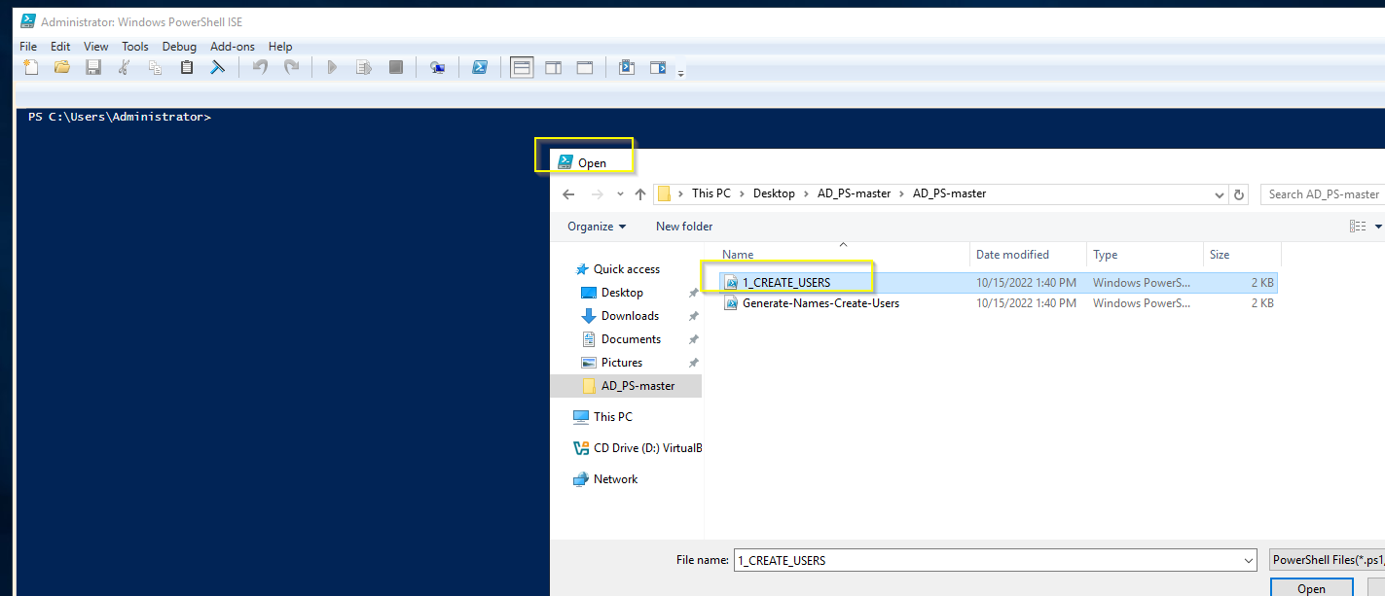

Slide 14
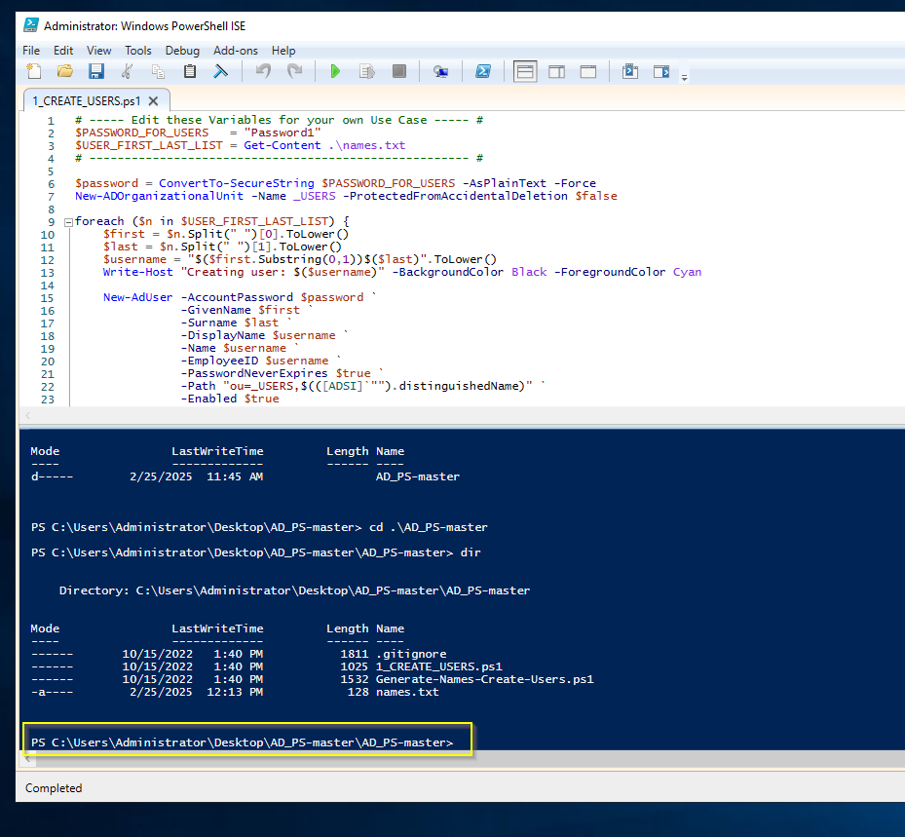
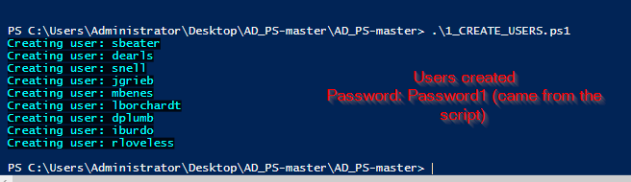

Slide 15
